Slide 1
Protecting Text in Steganography CSC 8224: Cryptography
Presenters Gaayathri Vaidhyanathan Pazhambalacode Gollangi Someswara Rao

Slide 2
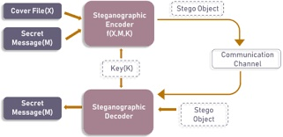
What is Steganography?
Steganography is the technique of hiding secret data within an ordinary, non-secret, file or message in order to avoid detection.
In other words, Steganography hides a secret message inside an innocent-looking cover medium, drawing no attention to itself. The cover medium can be text, image, music, video, network packets.
The content to be concealed through steganography -- called hidden text -- is often encrypted before being incorporated into the innocuous-seeming cover text file or data stream. If not encrypted, the hidden text is commonly processed in some way in order to increase the difficulty of detecting the secret content.

Slide 3
How is Steganography used today?
In modern digital steganography, data is first encrypted or obfuscated in some other way and then inserted, using a special algorithm, into data that is part of a particular file format such as a JPEG/PNG image, audio or video file. The secret message can be embedded into ordinary data files in many different ways.
One technique is to hide data in bits that represent the same color pixels repeated in a row in an image file. By applying the encrypted data to this redundant data in some inconspicuous way, the result will be an image file that appears identical to the original image but that has "noise" patterns of regular, unencrypted data.
While there are many different uses of steganography, including embedding sensitive information into file types, one of the most common techniques is to embed a text into an image file.

Slide 4
Image Steganography
Hiding the data by taking the cover object as the image is known as image steganography. In digital steganography, images are widely used cover source because there are a huge number of bits present in the digital representation of an image. There are a lot of ways to hide information inside an image.
Common approaches include:
Least Significant Bit Insertion
Masking and Filtering
Redundant Pattern Encoding
Encrypt and Scatter
Coding and Cosine Transformation

Slide 5
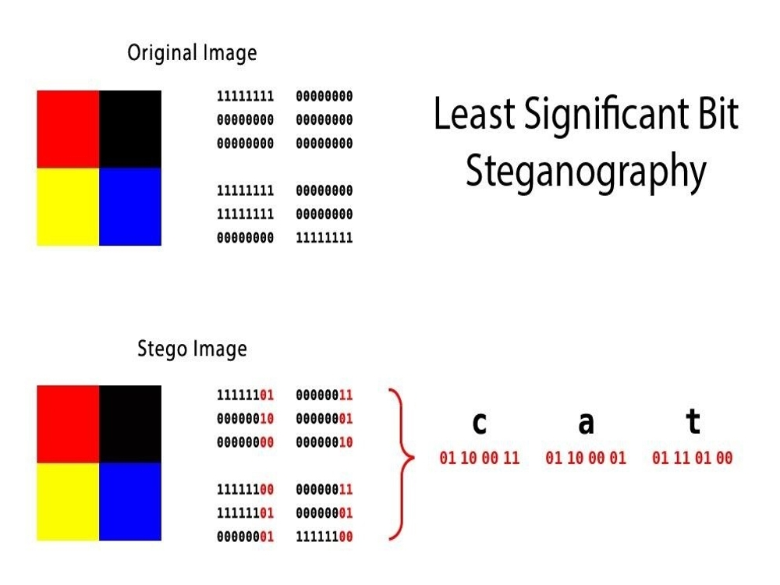
Image Steganography using LSB
One of the most popular techniques is 'least significant bit (LSB) steganography. In this type of steganography, the information hider embeds the secret information in the least significant bits of a media file.
Since modifying the last bit of the pixel value doesn’t result in a visually perceptible change to the picture, a person viewing the original and the steganographically modified images won’t be able to tell the difference.

Slide 6
Steganography Software
Steganography software is used to perform a variety of functions in order to hide data, including encoding the data in order to prepare it to be hidden inside another file, keeping track of which bits of the cover text file contain hidden data, encrypting the data to be hidden and extracting hidden data by its intended recipient.
There are proprietary as well as open source and other free-to-use programs available for doing steganography. OpenStego is an open source steganography program; other programs can be characterized by the types of data that can be hidden as well as what types of files that data can be hidden inside. Some online steganography software tools include Xiao Steganography, used to hide secret files in BMP images or WAV files; Image Steganography, a Javascript tool that hides images inside other image files; and Crypture, a command line tool that is used to perform steganography.

Slide 7
Problem Formulation
There are a few issues on steganography sites, one of which is the page's security. There usually is no security for encrypted files, so if a third party or someone other than the sender and receiver gets access to the information, they can decode it easily.
We propose developing a login site for our application to address this issue with certain level of authentication techniques involved. This way only the sender and receiver may only read the message hidden in the steganography text or image.

Slide 8
Objectives/Methodology
There are three interfaces in this application: registration, login, Steganographic encryption and Steganographic decryption.
Before connecting to the application, the client must first register, and he or she must enter a PIN as a multi-factor authentication when using a username and password.
After logging in, the user can create content, encrypt it, and share it with the recipient of the secret message.
The main objectives of the proposed project include:
Creating a more secured approach for the steganography.
Creating and linking Two factor authentication.
Having a smooth process for the user

Slide 9
Implementation

Slide 10
THANK YOU!

